Slide 1


Adaptable Automatic Fire Detection and Warning System
CMPE363 Section 1
Fuat Yiğit Koçyiğit
Zülal Karın
Zeynep Ayca Tanışlı
Notes:
Hello and welcome to our project presentation for an automatic fire detection and warning system based on camera footage.

Slide 2



About Us
Zülal Karın
Zeynep Ayca Tanışlı
TED University
Computer Engineering 4th Grade Student
TED University
Computer Engineering 4th Grade Student
Fuat Yiğit Koçyiğit
TED University
Computer Engineering 4th Grade Student
Notes:
My name is Fuat Yiğit Koçyiğit and my groupmates are Zülal Karın and Zeynep Ayca Tanışlı.

Slide 3
Table of contents
Introduction
Problem Definition
01
02
Solution
Results
03
04
Notes:
Our presentation consists of four sections.

Slide 4
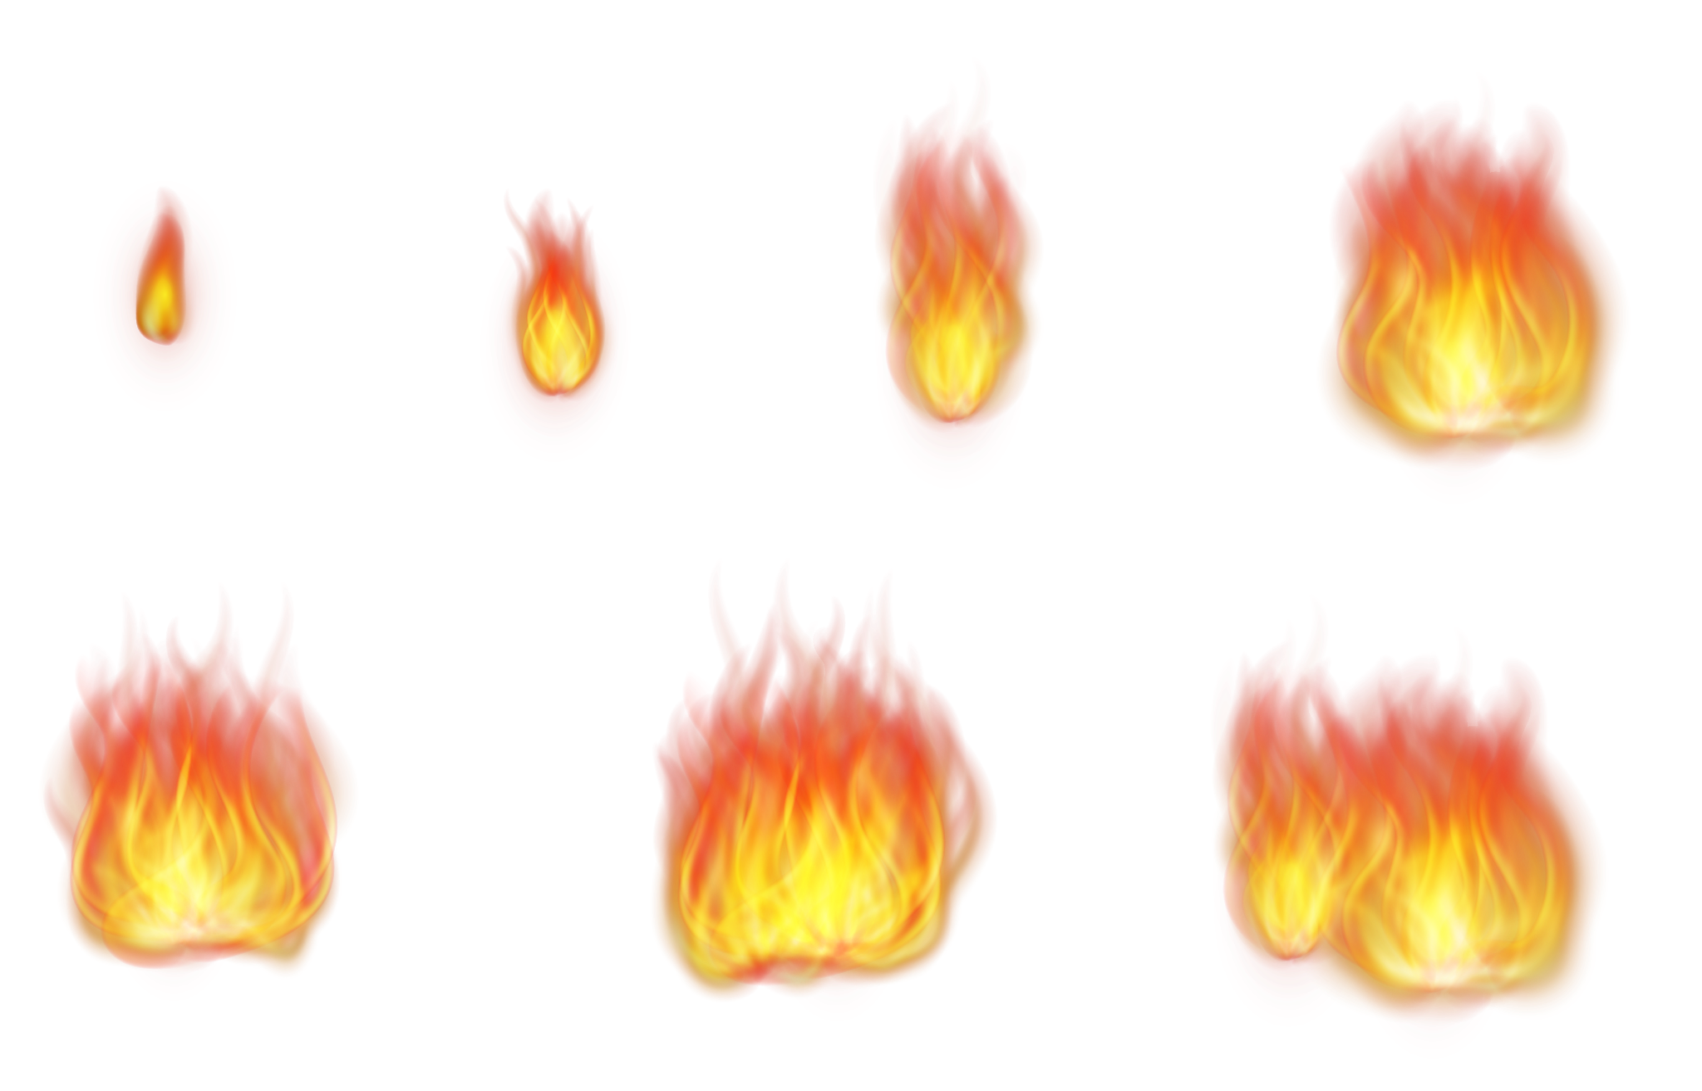
Introduction
01
Notes:
Firstly, we want to briefly introduce our project and concept.

Slide 5
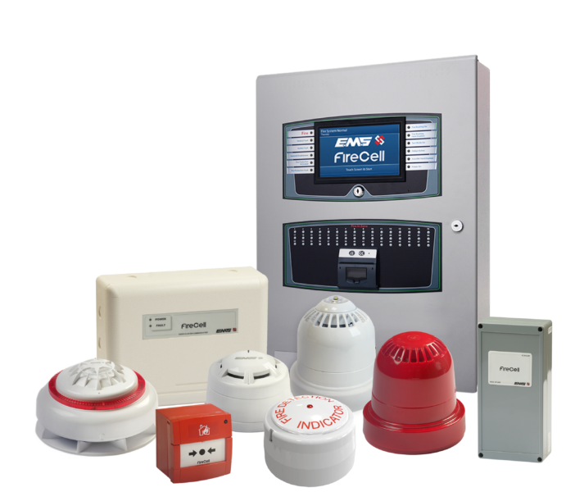

Our Subject
Our Goal
Our Aim
Auto-detect fires
Adaptable with every system
Real-time alerts
Detect fires as soon as they occur
Don’t allow wrong alarms
Notes:
The primary goal of our project is to automatically detect fires using images or time-lapse photos taken from camera recordings, and to provide users with real-time alerts and email notifications. The quick detection of fires is of vital importance. Therefore, with the algorithms used in our project, we aim to detect fires as soon as they occur.

Slide 6
Problem Definition
02
Notes:
Now, we want to talk about our problem statement.

Slide 7
Some Bad Examples
2021
Big forest fires in Antalya in 2021
2016
2016 student dormitory fire caused by electrical contact in Adana
Notes:
Recent fires like Big forest fires in Antalya in twenty twenty one and twenty sixteen student dormitory fire caused by electrical contact in Adana could have been prevented or the damage could have been reduced by 90% with early detection. At the same time, house and skyscraper fires are often caused by small flames that go unnoticed. By the time the fire is detected and firefighters arrive, the fire can reach an uncontrollable point.

Slide 8
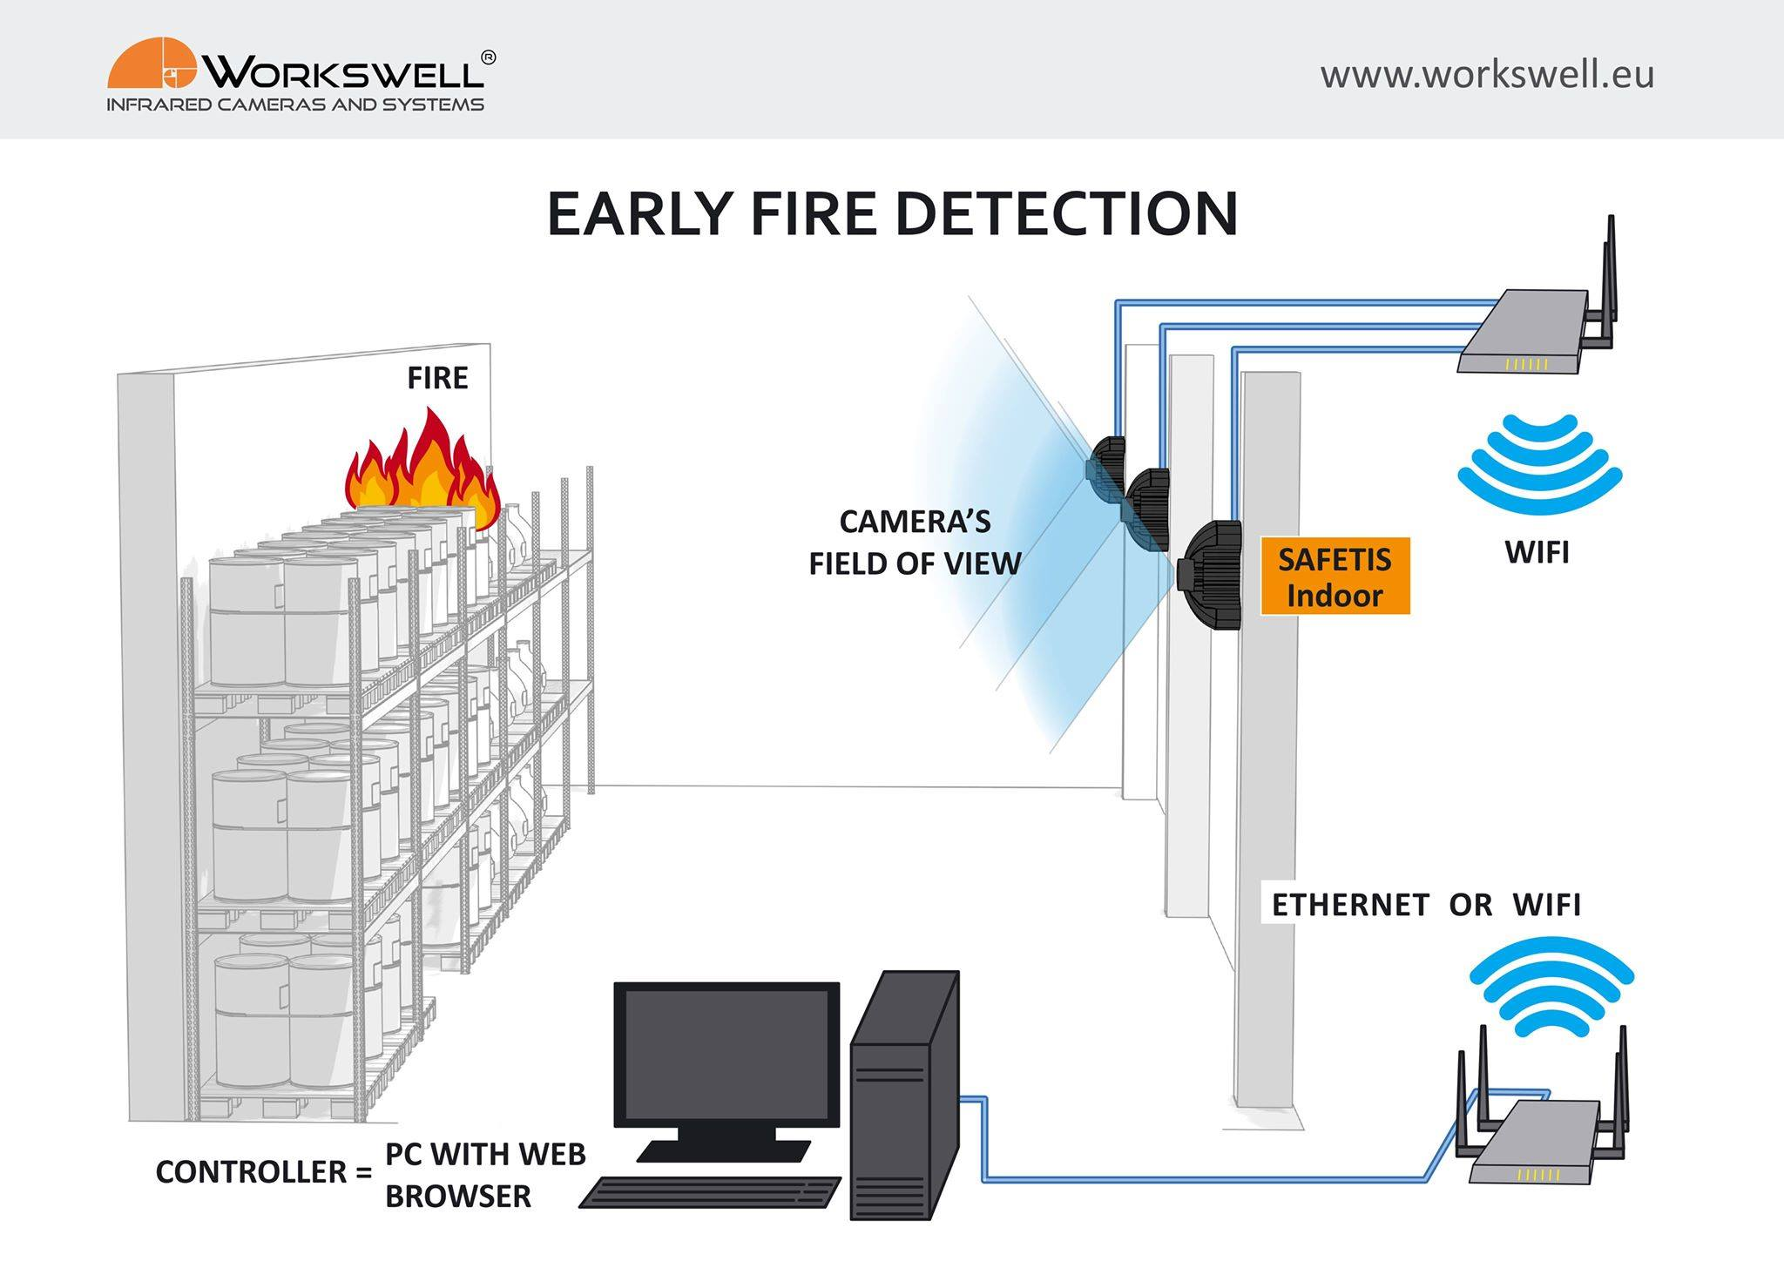
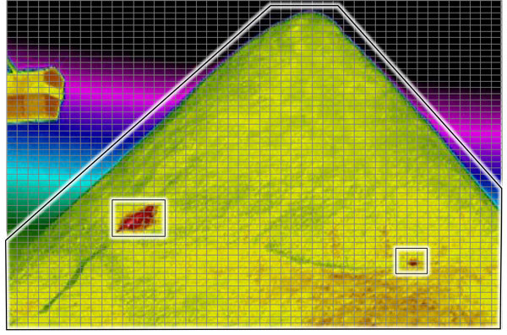
The Risk and Challenges
Quick Response
Correct Intervention
Early Detection
Notes:
Fires are serious incidents that can lead to loss of life, material damage, and environmental destruction. Early detection of fires is vital for a quick response and to minimize damage. Unfortunately, current fire detection systems may have some limitations that can make it difficult to detect fires in the early stages. This is where automatic fire detection systems come into play, shortening the intervention time by detecting fires early. Automatic fire detection is essential to mitigate the impact of potential fire damage. With early detection, it is possible to control fires before they grow. Also, automatic fire detection systems reduce the risk of human error. Therefore, in any fire situation, the use of an automatic fire detection system provides a faster and more accurate response.

Slide 9
Solution
03
Notes:
Now, let's talk about our solution, our project.

Slide 10
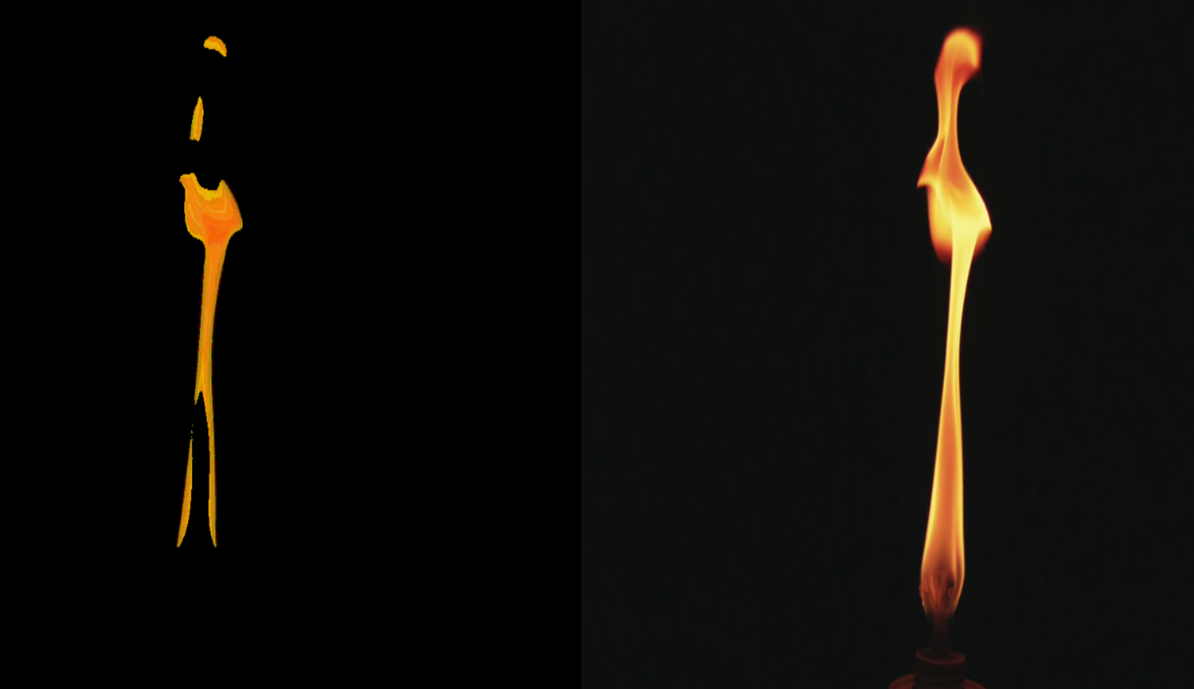
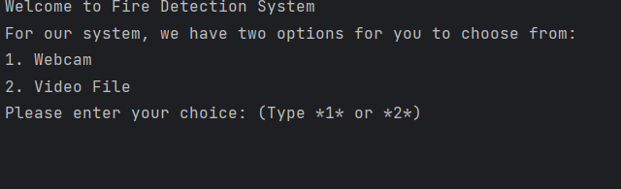
Our Program
Works with Camera or Video Data
Can Provide 24/7 Service
Integrable to All Systems
Notes:
Our solution is a system that automatically detects fires using images or time-lapse photos obtained from camera recordings, and informs the user with real-time alerts and email notifications. We developed our project using the Python programming language. Our system keeps the original image and the masked image where we detected the fire on the screen. It switches to alert mode when there's a possibility of fire detection and quickly performs necessary actions.

Slide 11
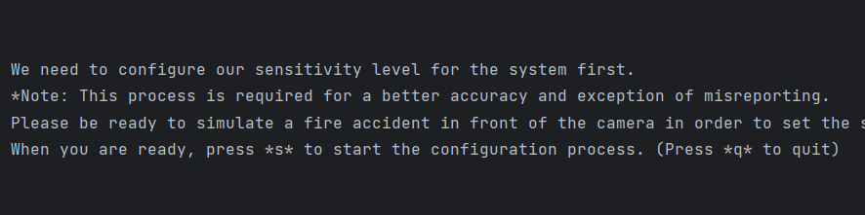
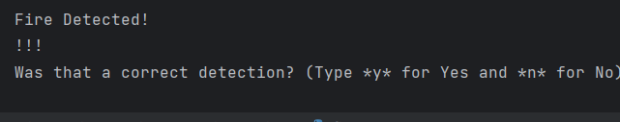
How the program works
Notes:
Let's start by explaining the basic code structure of our project. Firstly, we import the modules we will use in our project. These include modules like cv2 (OpenCV), numpy, smtplib, playsound, and threading, as well as other modules you may need to meet the requirements of our project.
At the start of the code, we define variables like Alarm_Status, Email_Status, and Fire_Reported. These variables are used to monitor situations like the alarm status, email status, and the number of fires detected.
We use two important functions to make our project work: 'play_alarm_sound_function' and 'send_mail_function'.
'play_alarm_sound_function' provides the audible alarm to be played when a fire is detected. This function plays a sound file using the 'playsound' module and repeats it continuously.
'send_mail_function' sends an email and whatsapp notification to the user when a fire is detected. This function connects to the SMTP server using the 'smtplib' module, sends the email, and then closes the server connection.
In our project, we perform frame reading from video. The 'video' variable reads frames from a video source using OpenCV. We also resize the video to optimize the process.
To detect fires, we calculate the number of red pixels in the frame. This number is used to determine the possibility of fire. If there is a number of red pixels above a certain threshold, the fire is considered detected and relevant actions are taken. These actions include sounding the alarm and sending email notifications.
When the program is runned for the first time, we request the input method from the user. The possibilities are real camera or video. We are requesting the path if the video is selected.
After the method is selected, the program gets ready for configuration phase. In that phase, we want user to simulate a small fire simulation. This phase is a must for setting the sensitiviy because the camera angles and sensitivity may be different from user to user. This process will automatically set the sensitivity. There will be no alarm.
After that, we want from user to stop the simulation. The program is now ready and will work infinitely ready to detection.

Slide 12

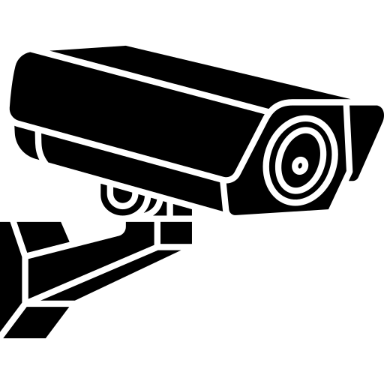
Benefits of our Program
Lightweight
No need for GPU
Sensitivity Setting
Low Memory
Competible with Camera and Video
Whatsapp Alert
Notes:
The biggest claim of our program is its small size and lightweight nature. It does not require a powerful GPU like other image processing systems. It has a very small structure in terms of size and is optimized for low memory usage. Additionally, sensitivity can be adjusted according to user demand.
Thanks to these features, we have created a system that can work with any camera or video footage. We can provide an early warning system by taking only a few frames per minute, greatly preventing major damage. Our alert management is via email and WhatsApp.

Slide 13

Results
04
Notes:
In conclusion,

Slide 14
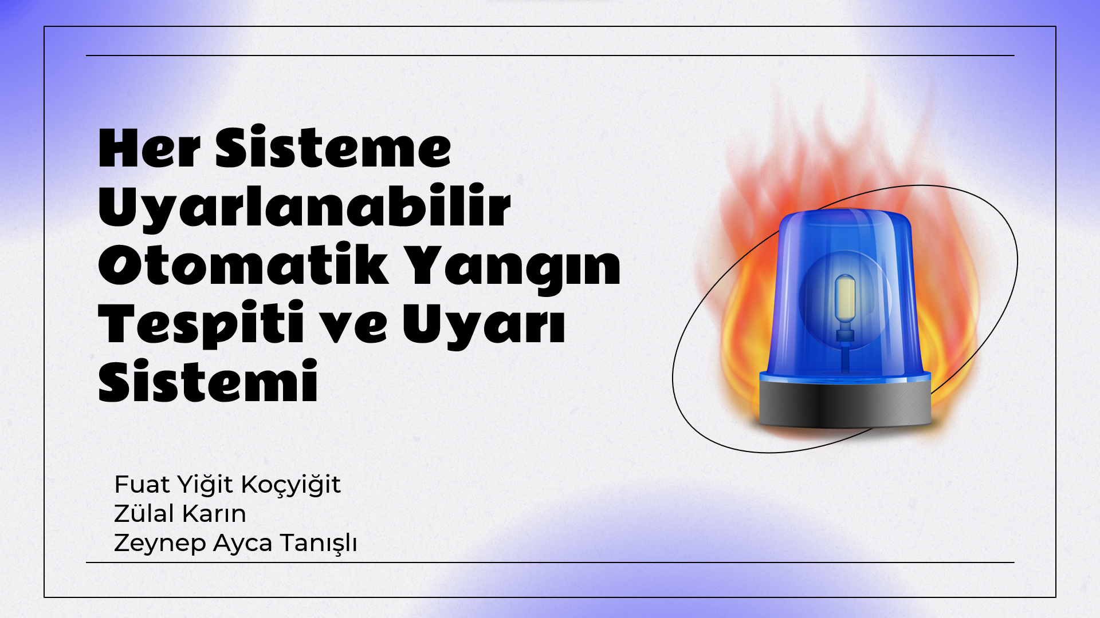
Results
We will show you a demo from our real program now.
For faster configuration phase, please make the place dark.
Notes:
The results we obtained using our project were very positive. In our tests, we observed that our system successfully detects fires. This provides a great advantage for the early detection of fires, especially in places that are difficult to notice or at times when no one is present.
Our future plans include further developing the project and expanding its features. For example, we can make fire detection more sensitive by adding thermal imaging capabilities to the project. We also aim to make improvements such as adding more alarm options to our system or providing more information as a result of fire detection.

Slide 15
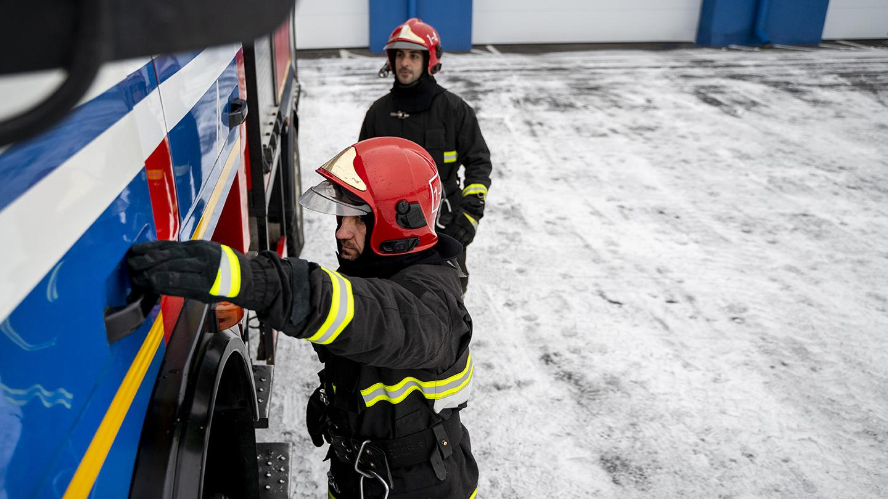

Thank you for listening Remember: every second in a fire can be equal to a life.
Notes:
Thank you for listening, remember: every second in a fire can be equal to a life.

